Slide 1
Jana
Lab meeting
2020-04-15
@HighlanderLab

Slide 2
Agenda
Papers
AlphaPart – simulation of import

Slide 3
Papers
AlphaPart:
Added figures (partition distribution instead of mean)
Ready for submission in GSE
Optimization of resources between phenotyping and genotyping
Work in progress, aiming to submit in GSE
Figures →

Slide 6
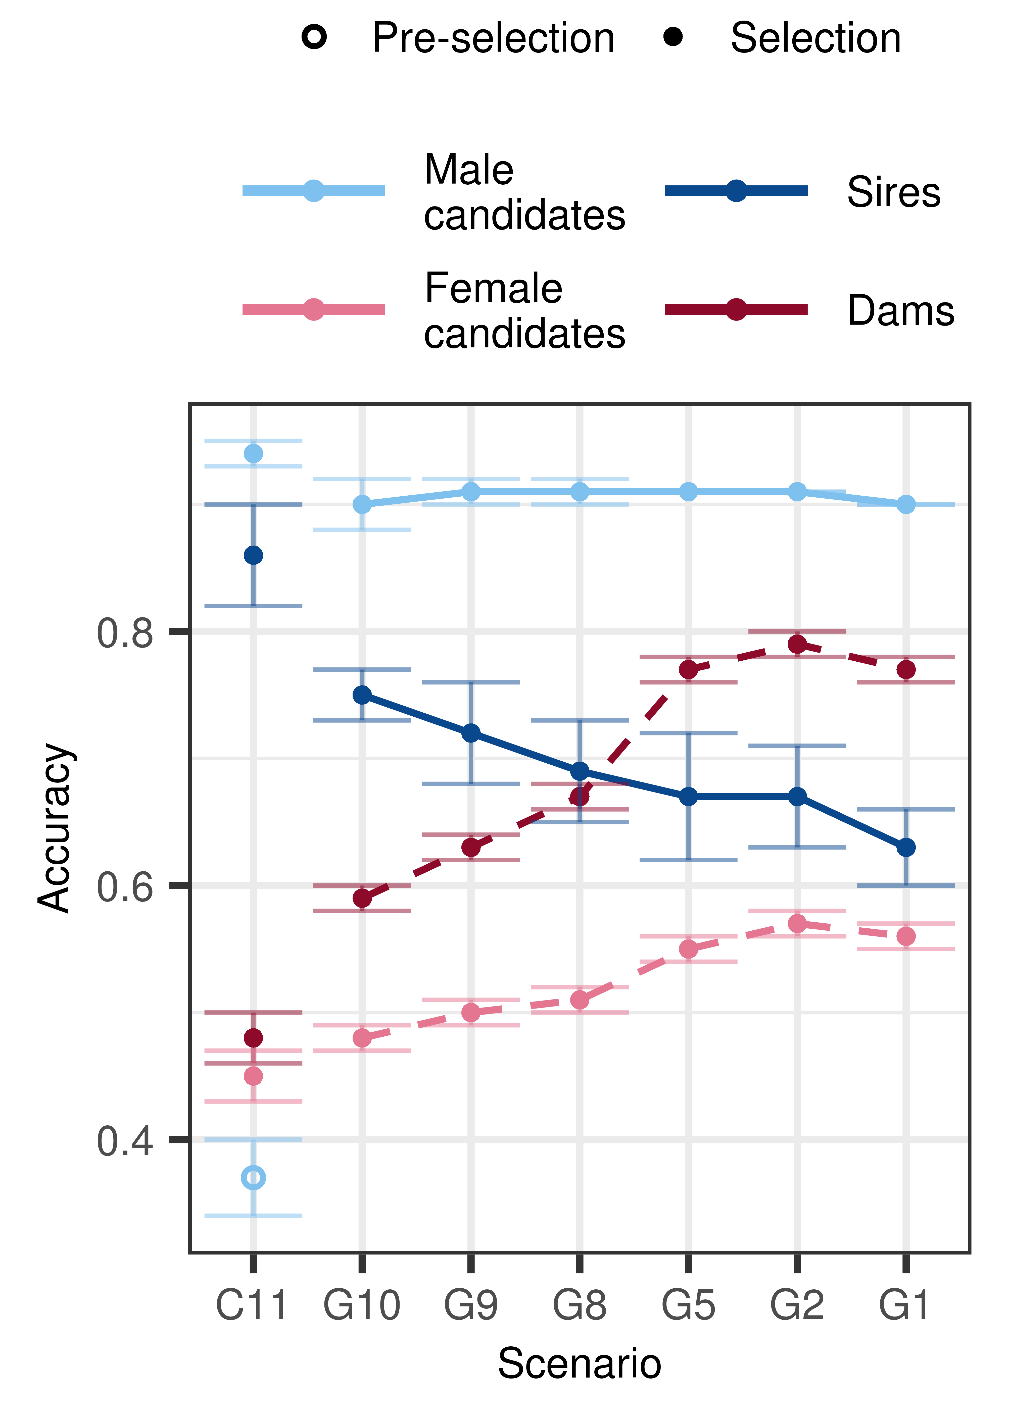
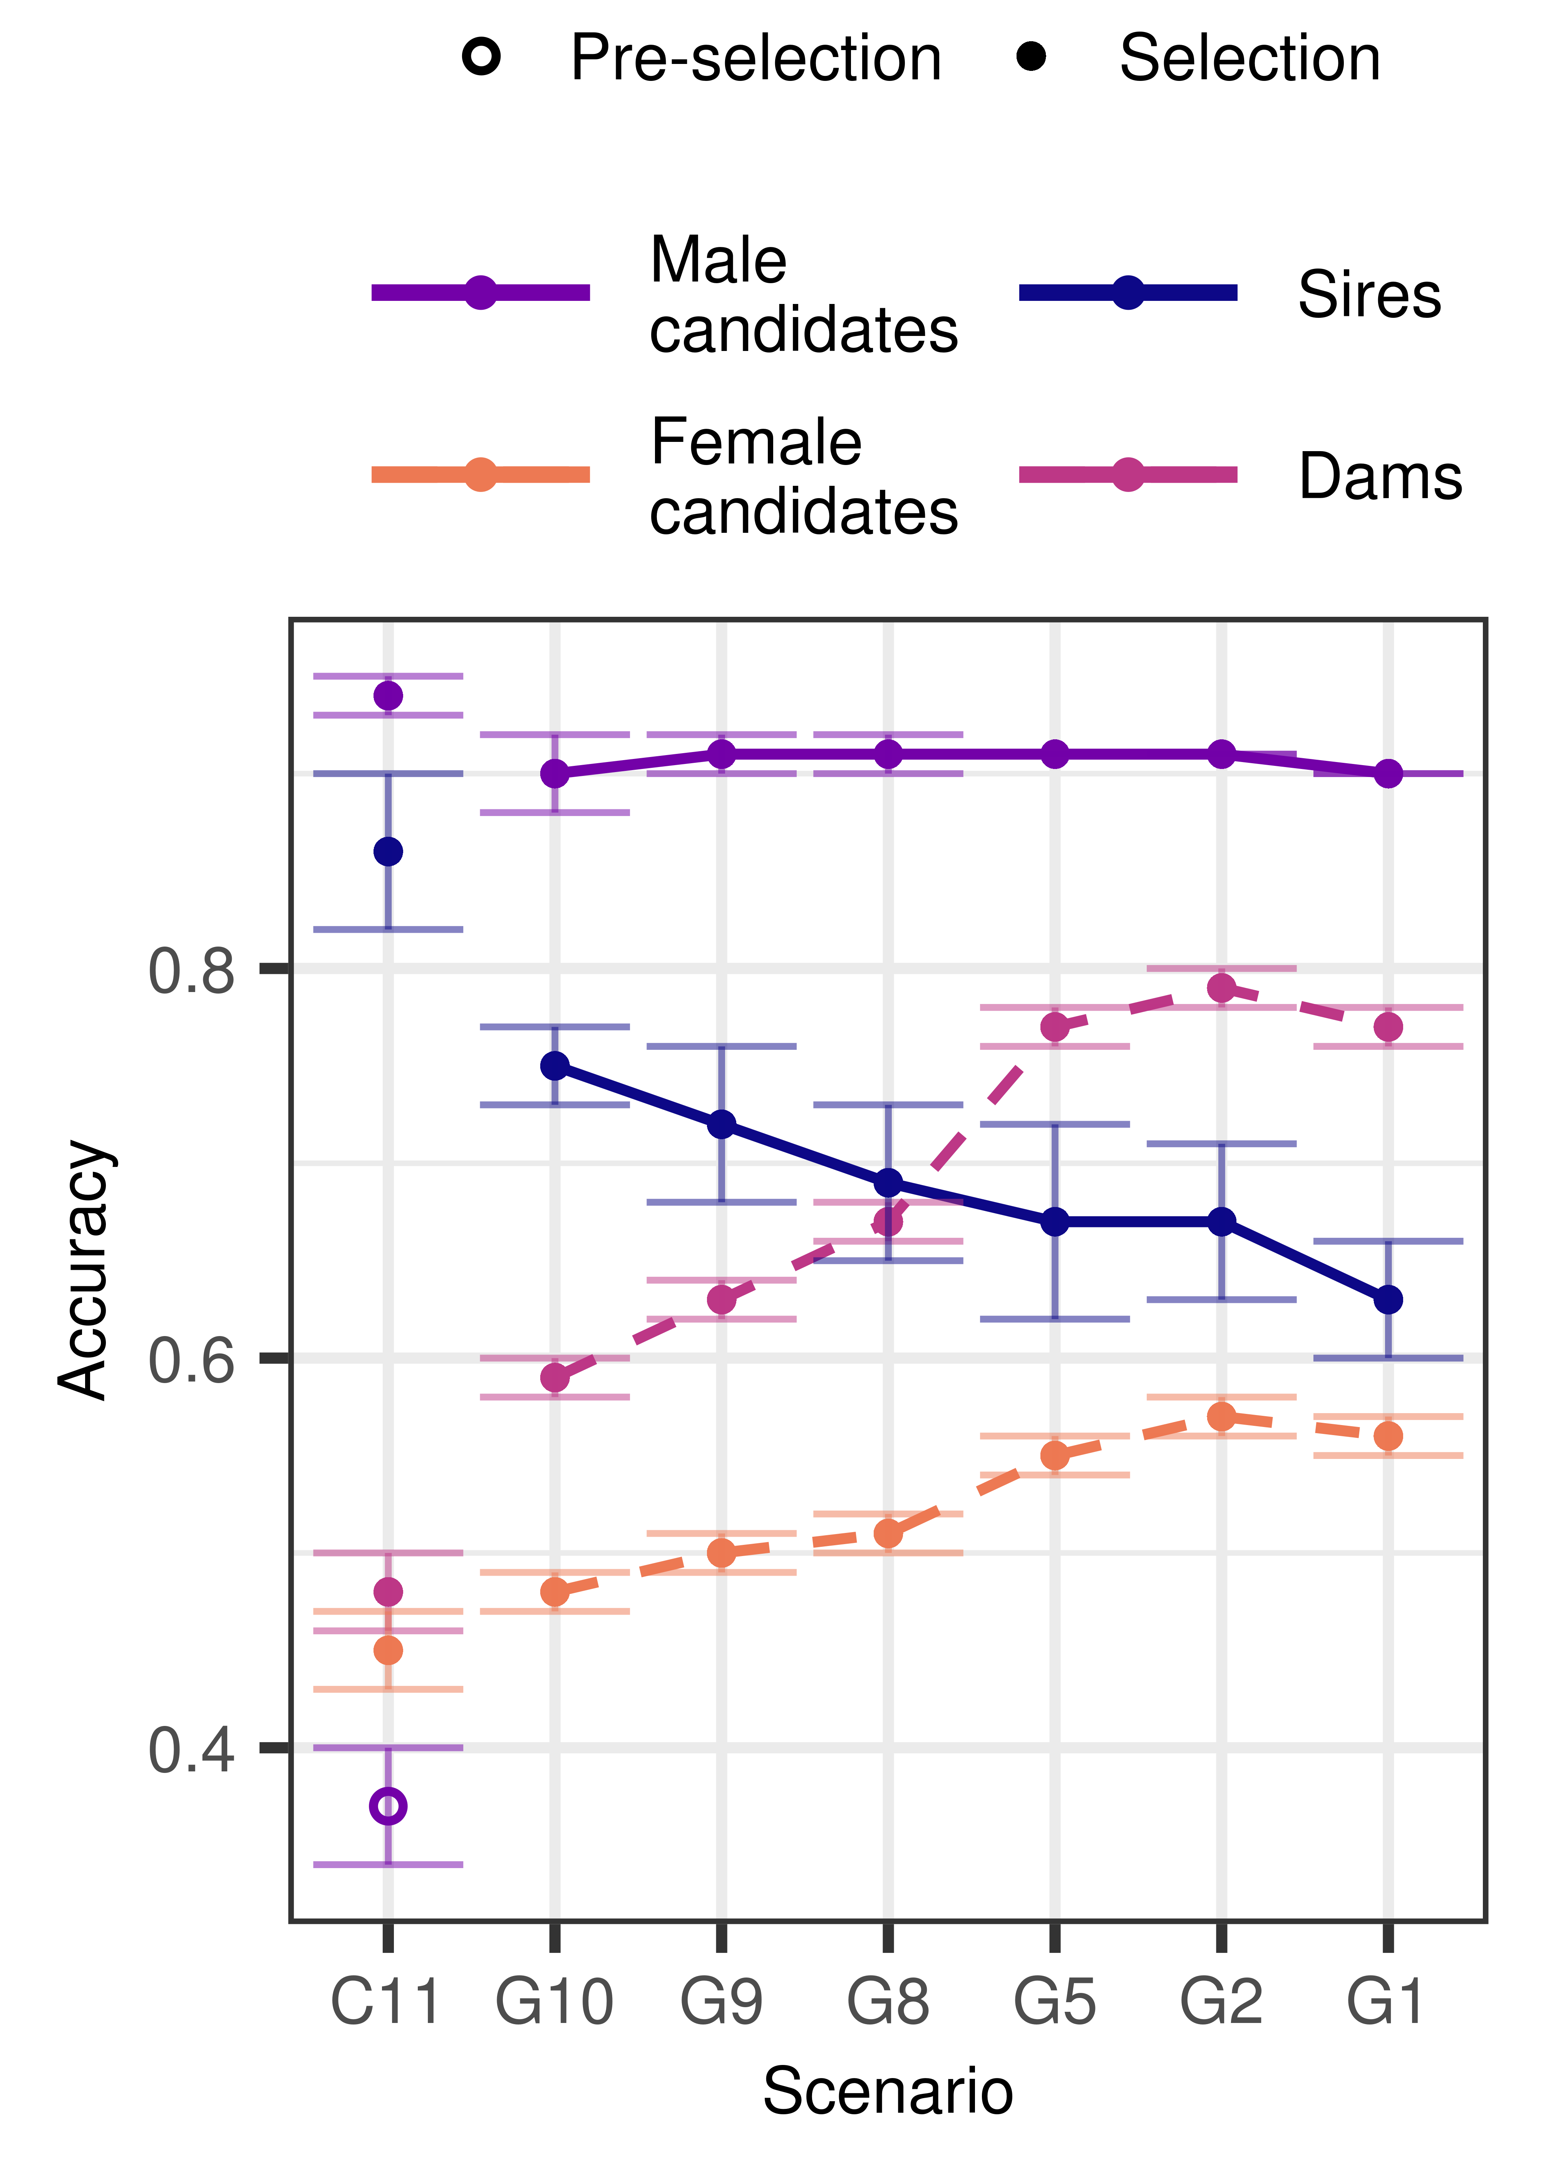
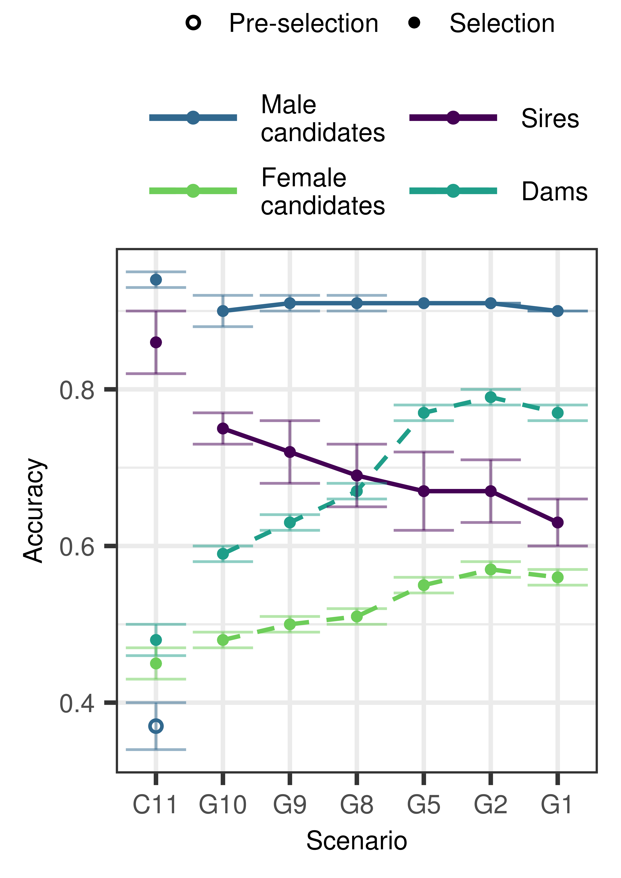

Slide 9

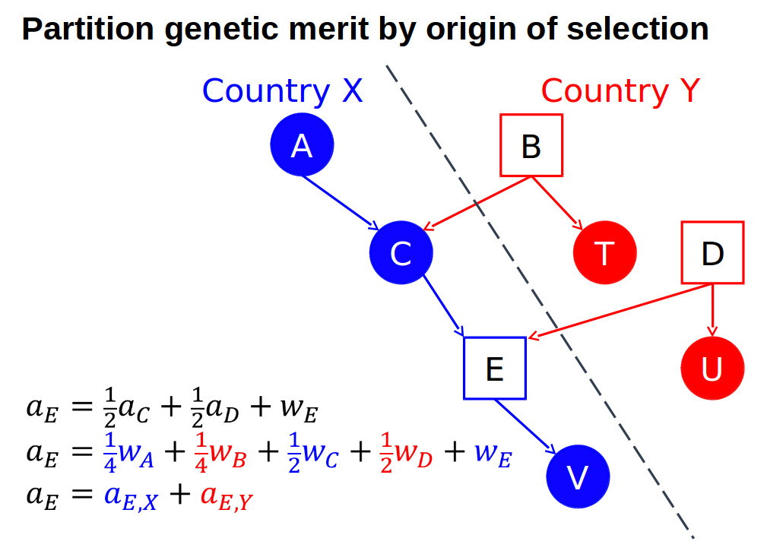
AlphaPart
R-package (CRAN)
Partitioning of genetic trend
(García-Cortés et al., 2008)
BY paths of information
PA
MST

Slide 10
Import: simulation - partition
Simulation of import of bulls:
Foreign population (higher ΔG: higher i and r)
Import into domestic population
Vary:
Progeny / genomic testing
Data for estimation
Import for bull dams / cows
Percent of import
Partition by origin-gender

Slide 11
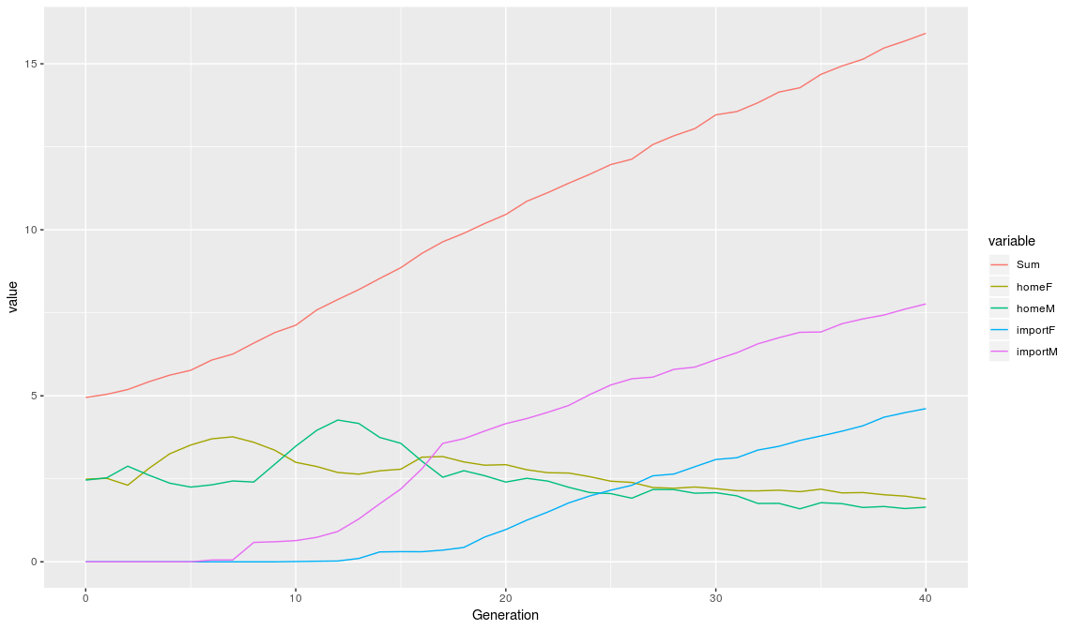
Import: simulation - partition

Slide 12
Other work
Reviewing two papers
Bee-work for Slovenian people

